Slide 1
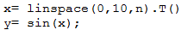
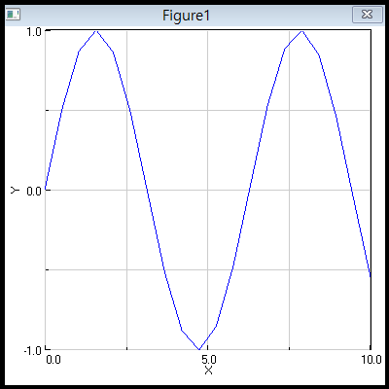
HW. 2.1 Sigmoidal NN for Sin(x)
0<x<10 → X=linspace(0,10,20) N=20
Y = sin(X)
Find the best NN result with Sigmoidal NN
W1 and W2 = zeros or randn
How many iterations are required?
Y= sin(x)

Slide 2
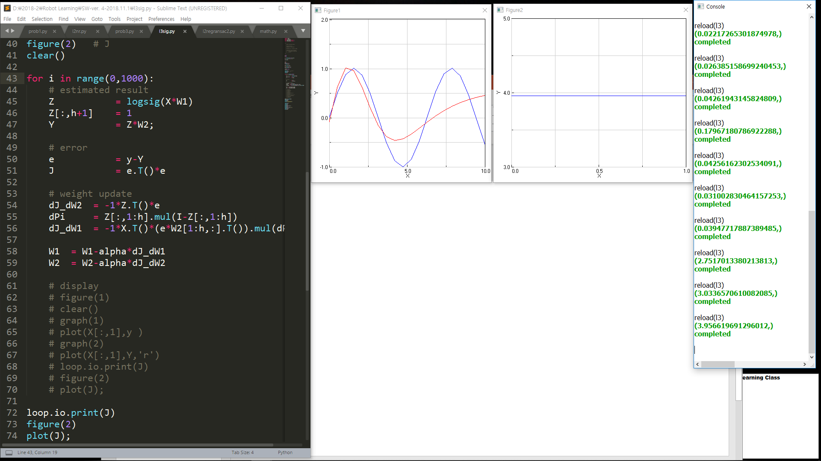
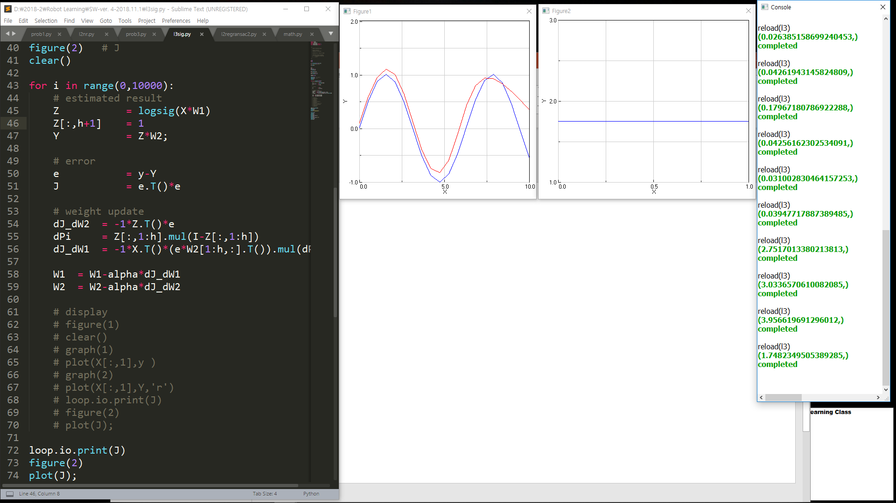
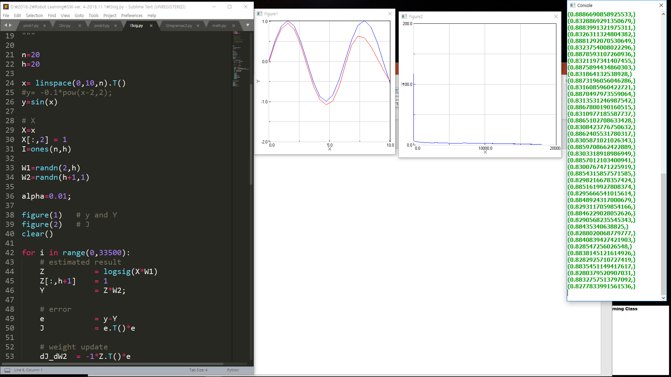

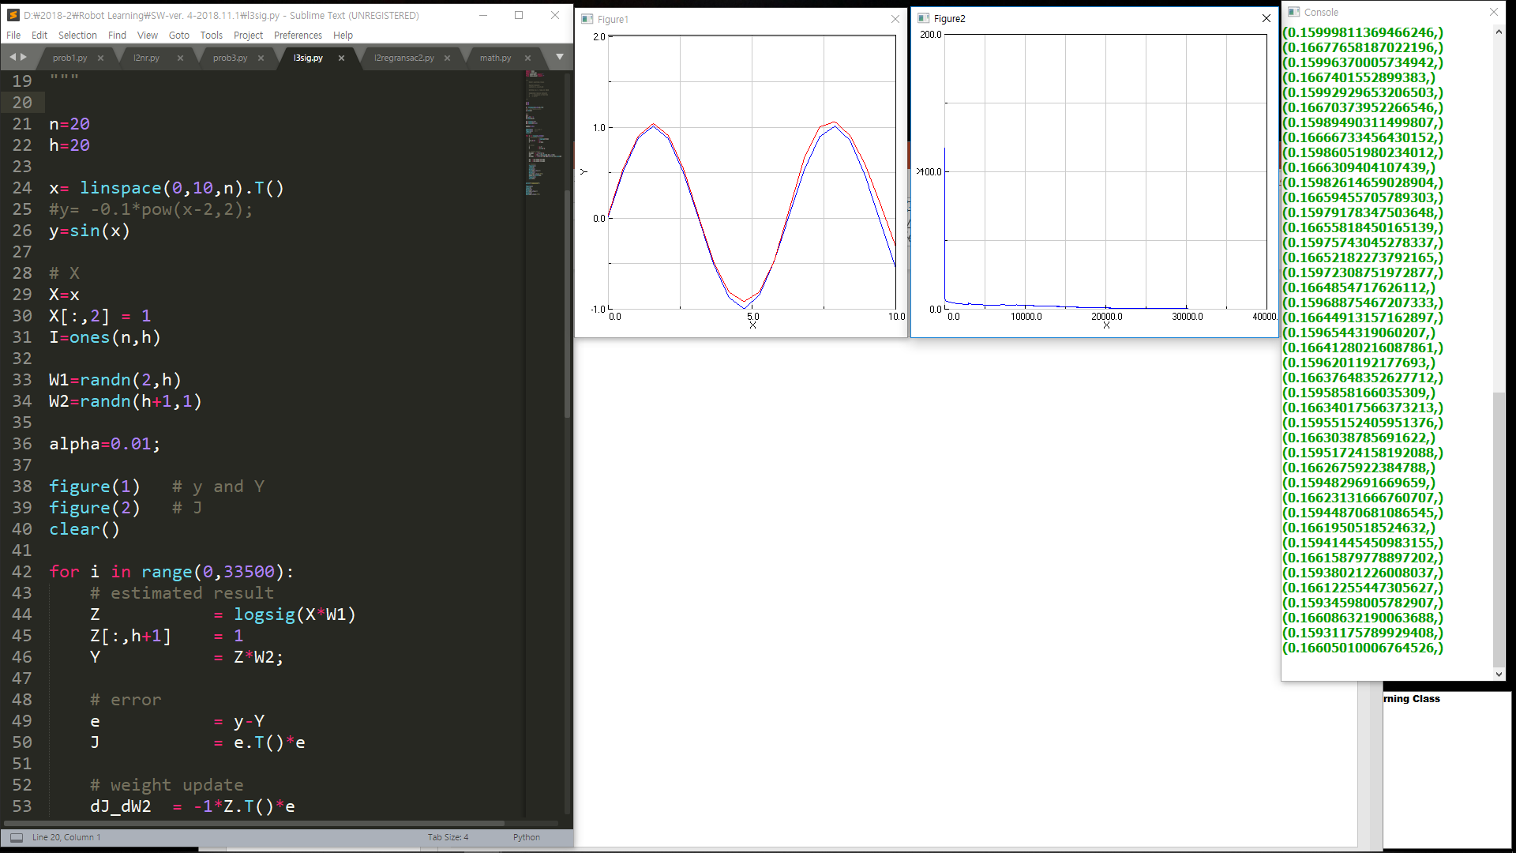
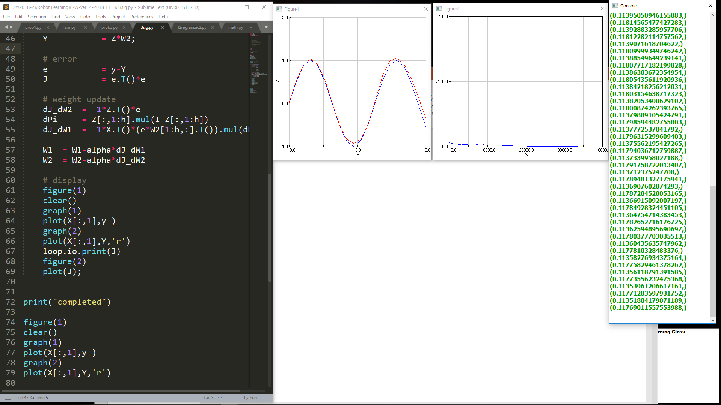
Notes:
1000번 – 만 번 – 만 팔천 - 2만 번 - 3만 번 이상

Slide 3
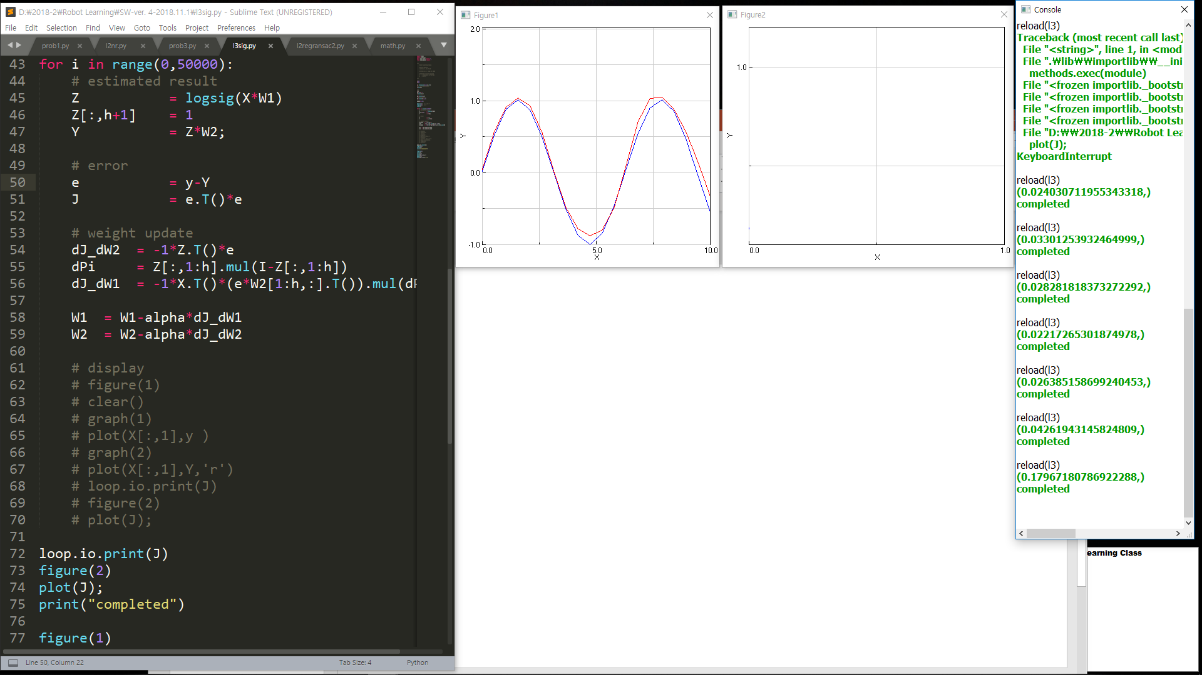

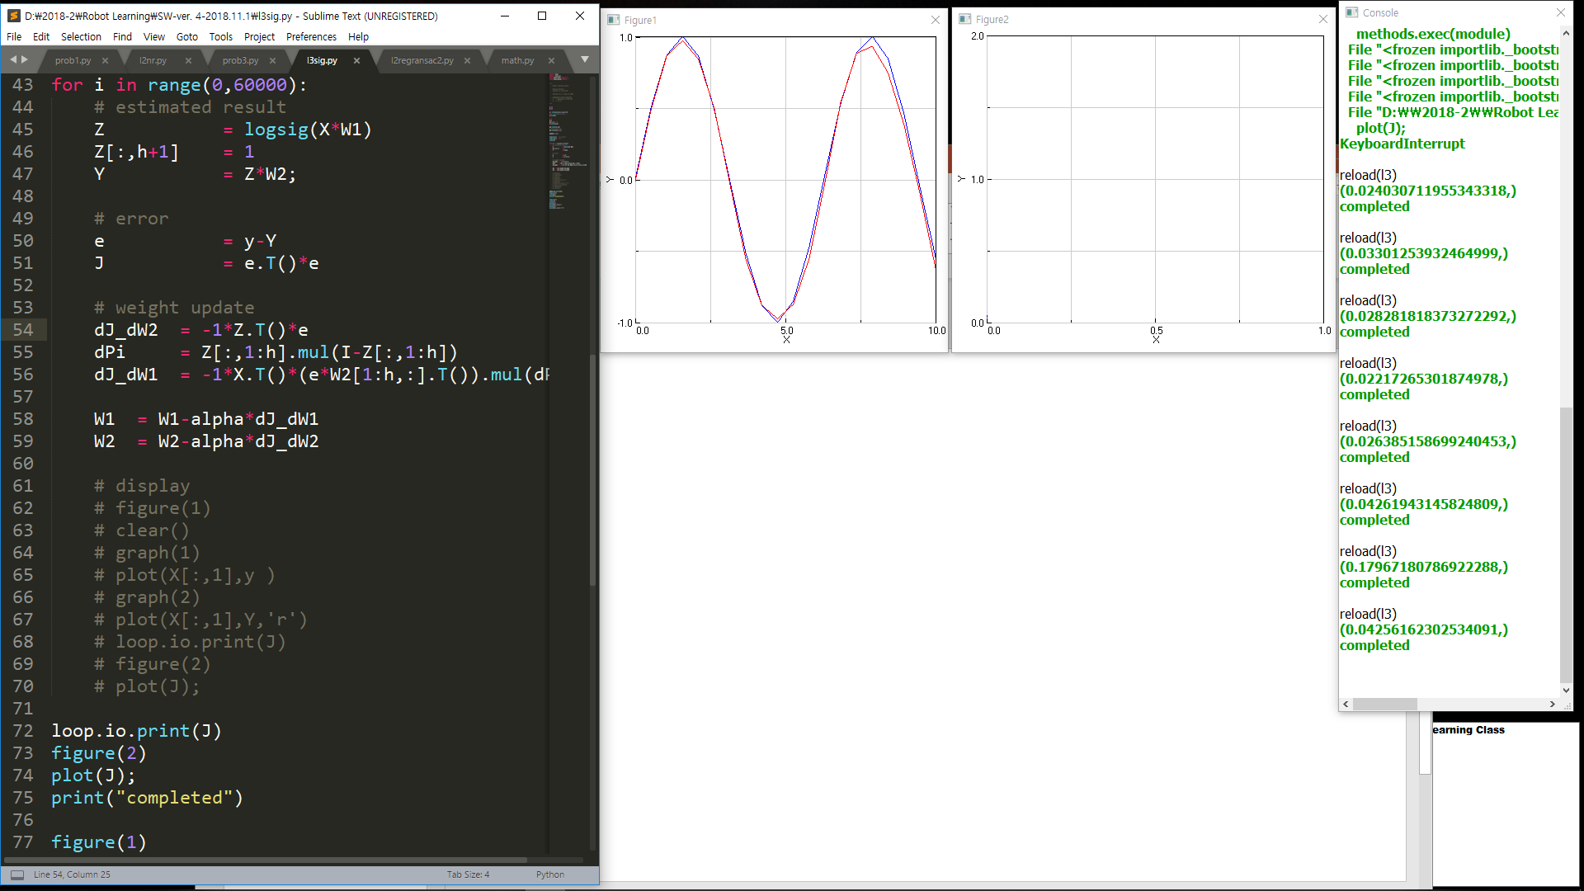
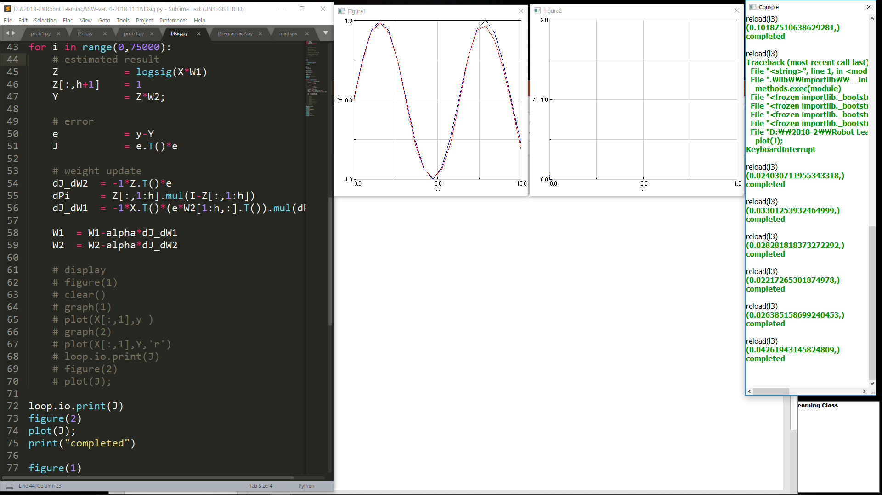
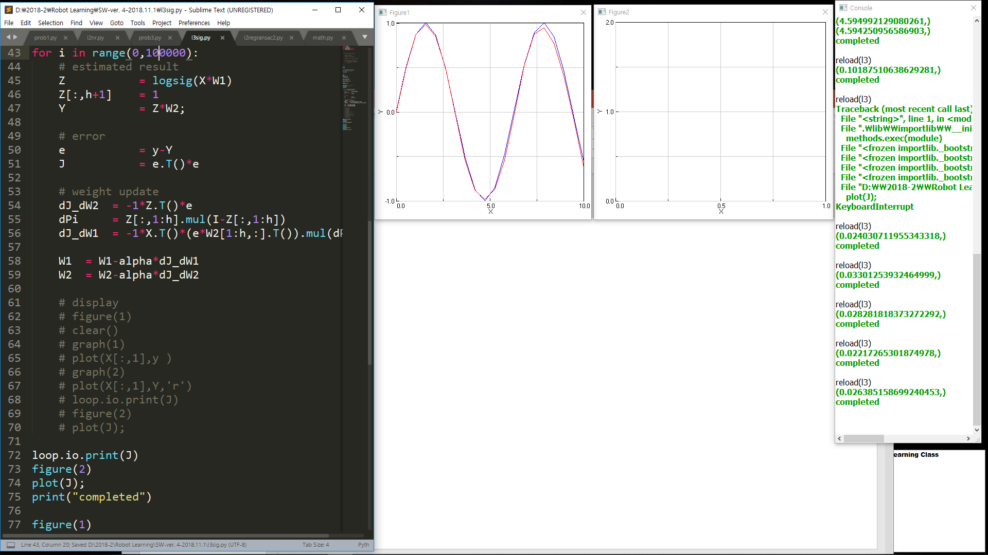
Notes:
5만 – 5만 5천 – (6만 = 7만5천 = 10만)

Slide 4
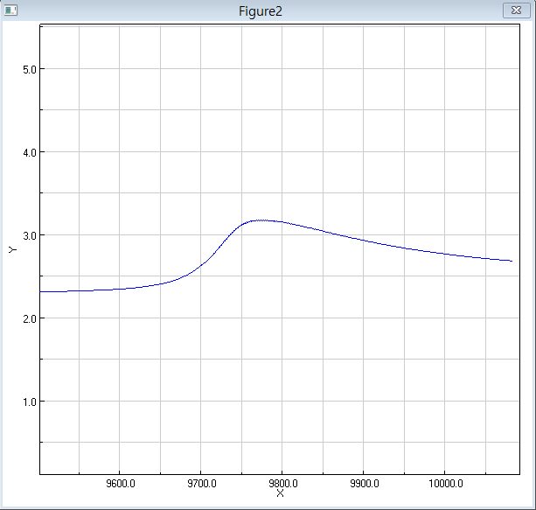
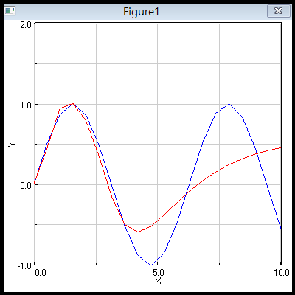
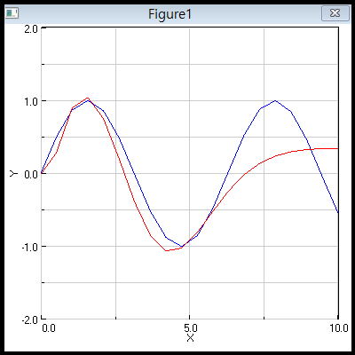
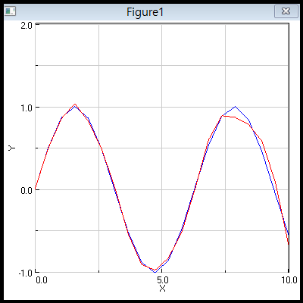
HW. 2.2 Why J shows this Phenomenon?
During Learning process,
J shows sudden Jump.
Why?

Slide 5


Slide 6
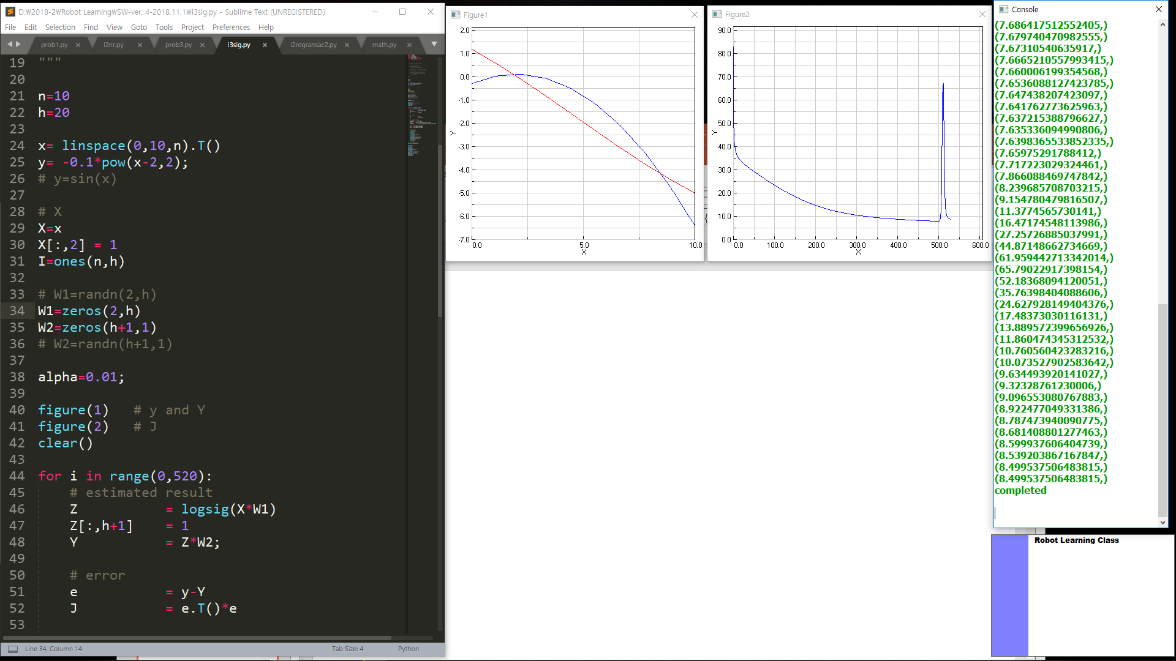
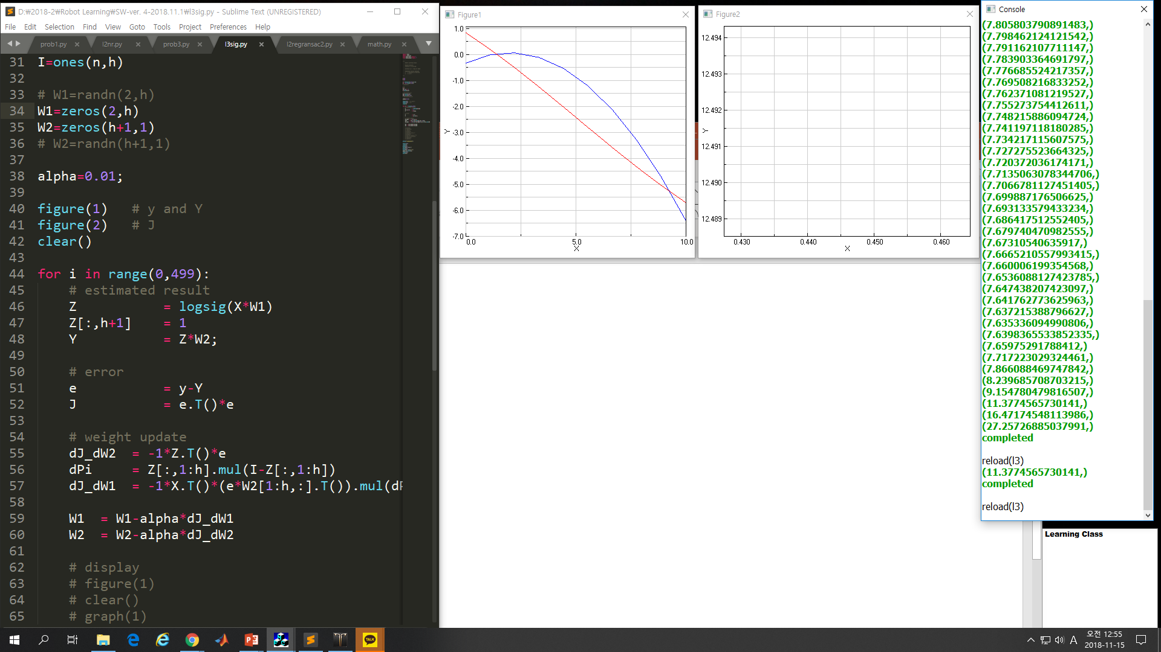
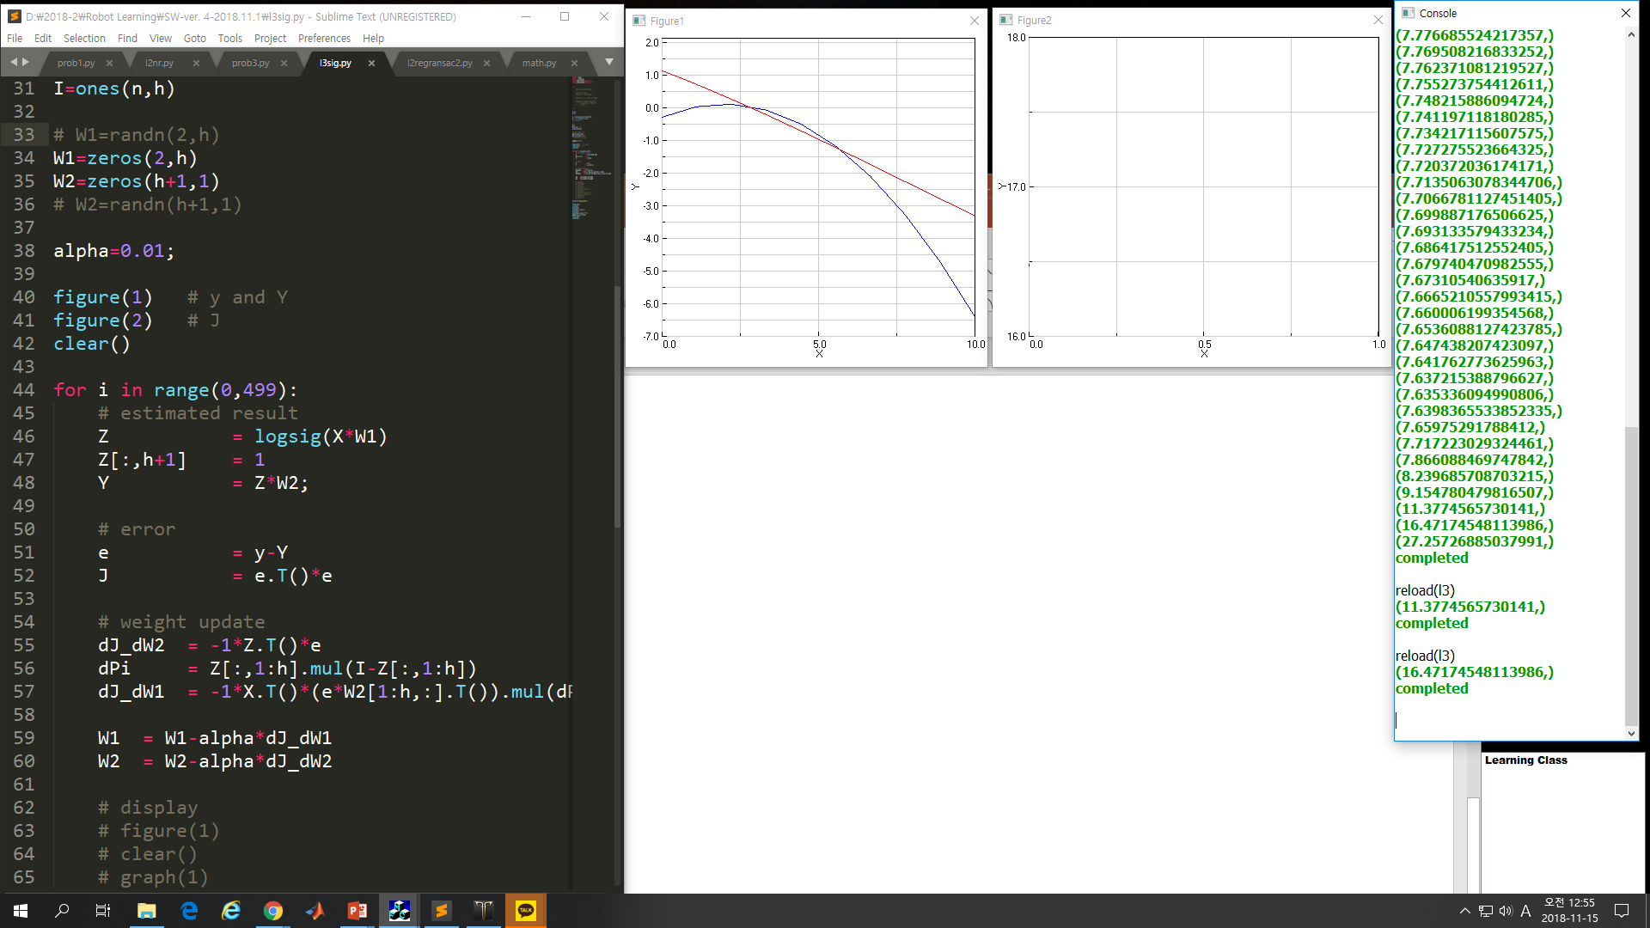
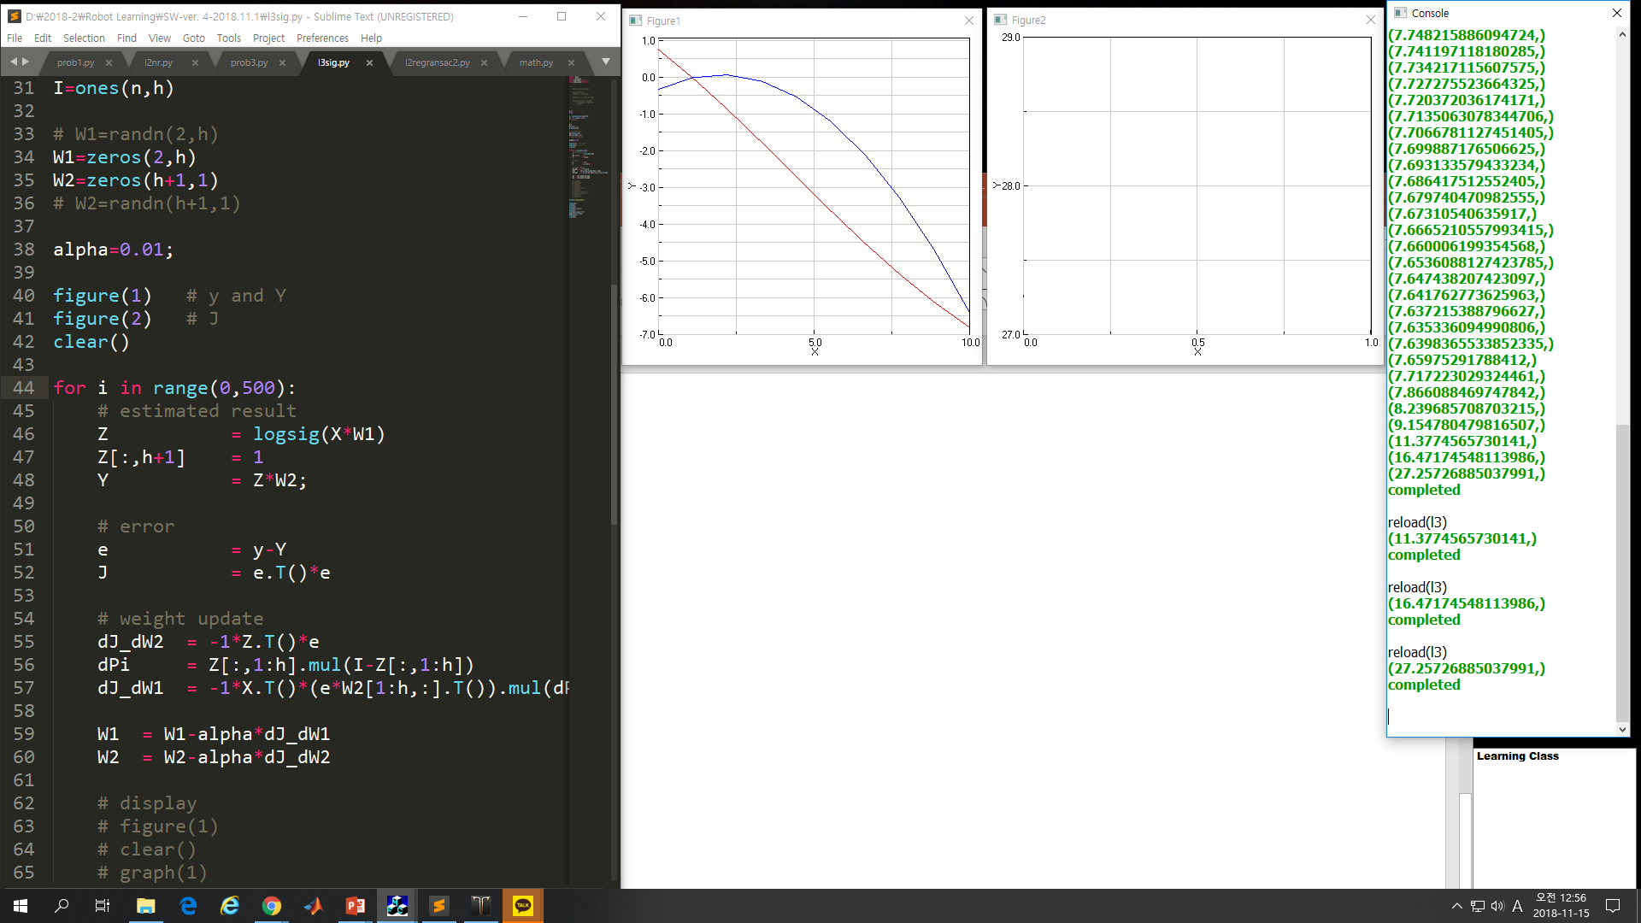
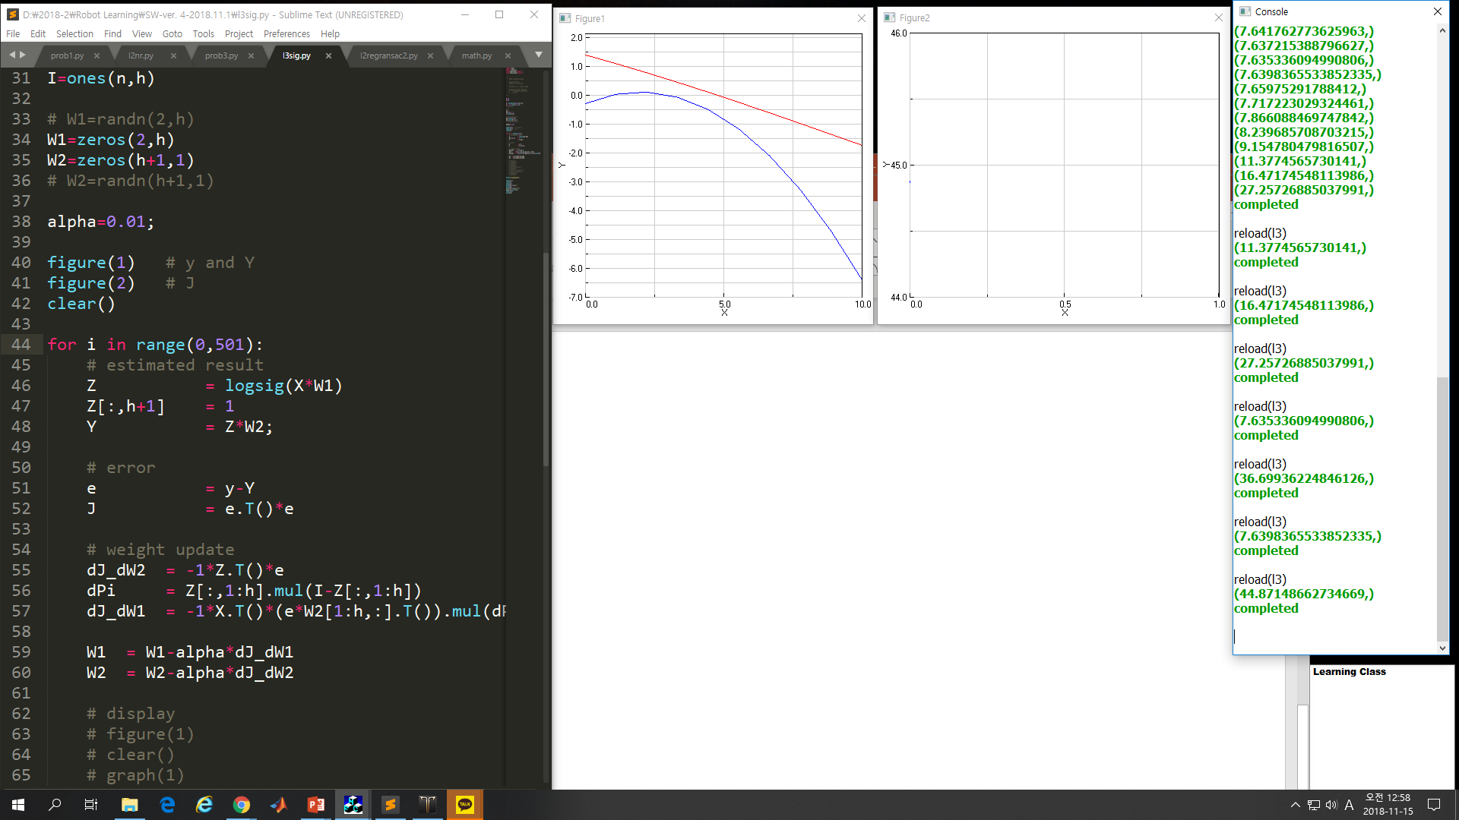
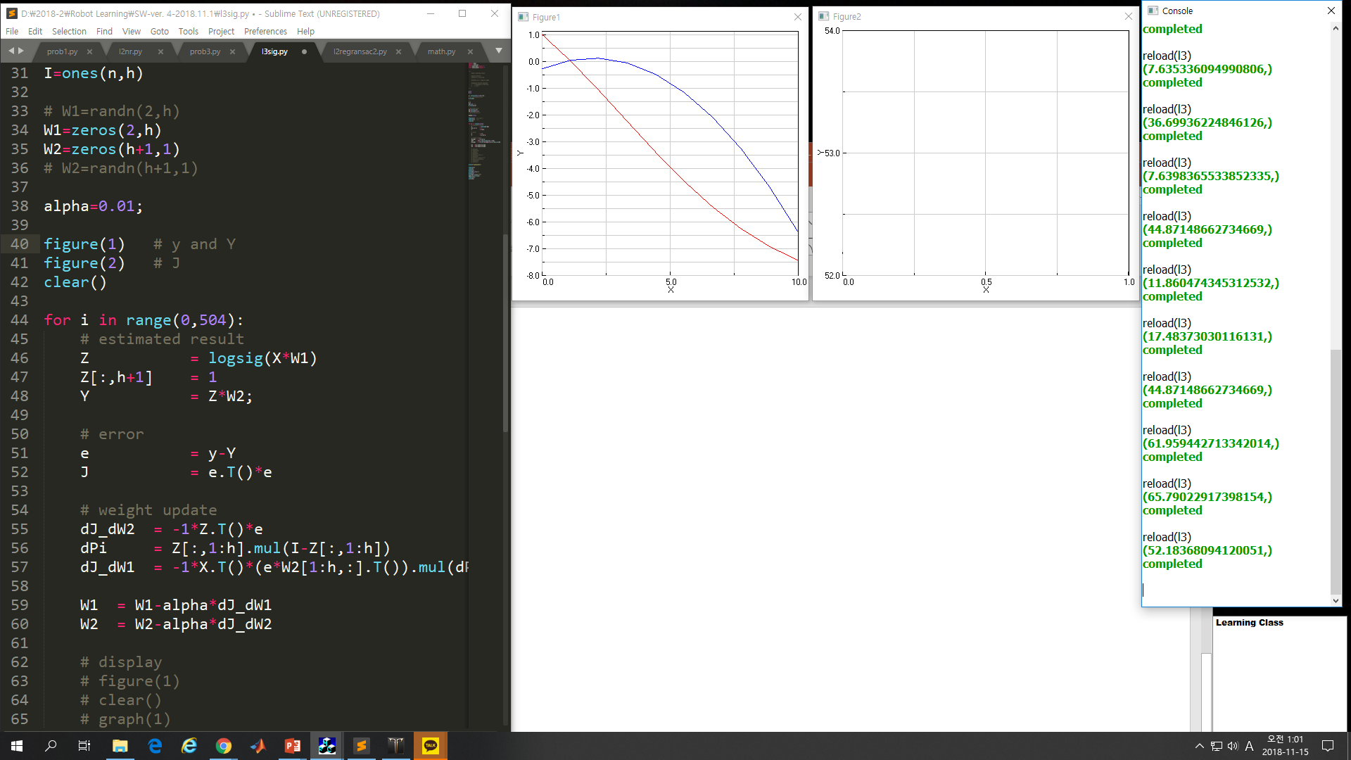
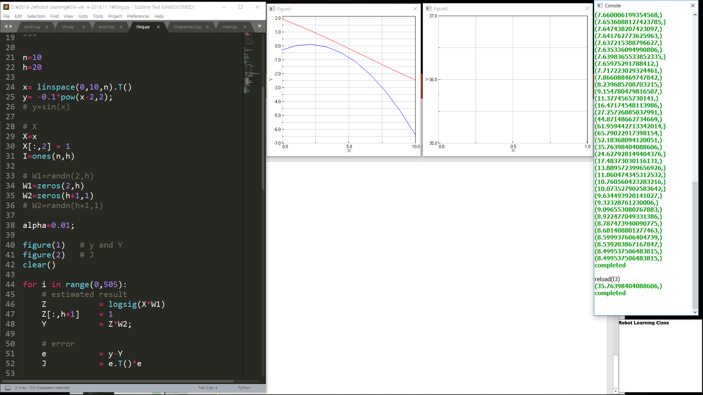
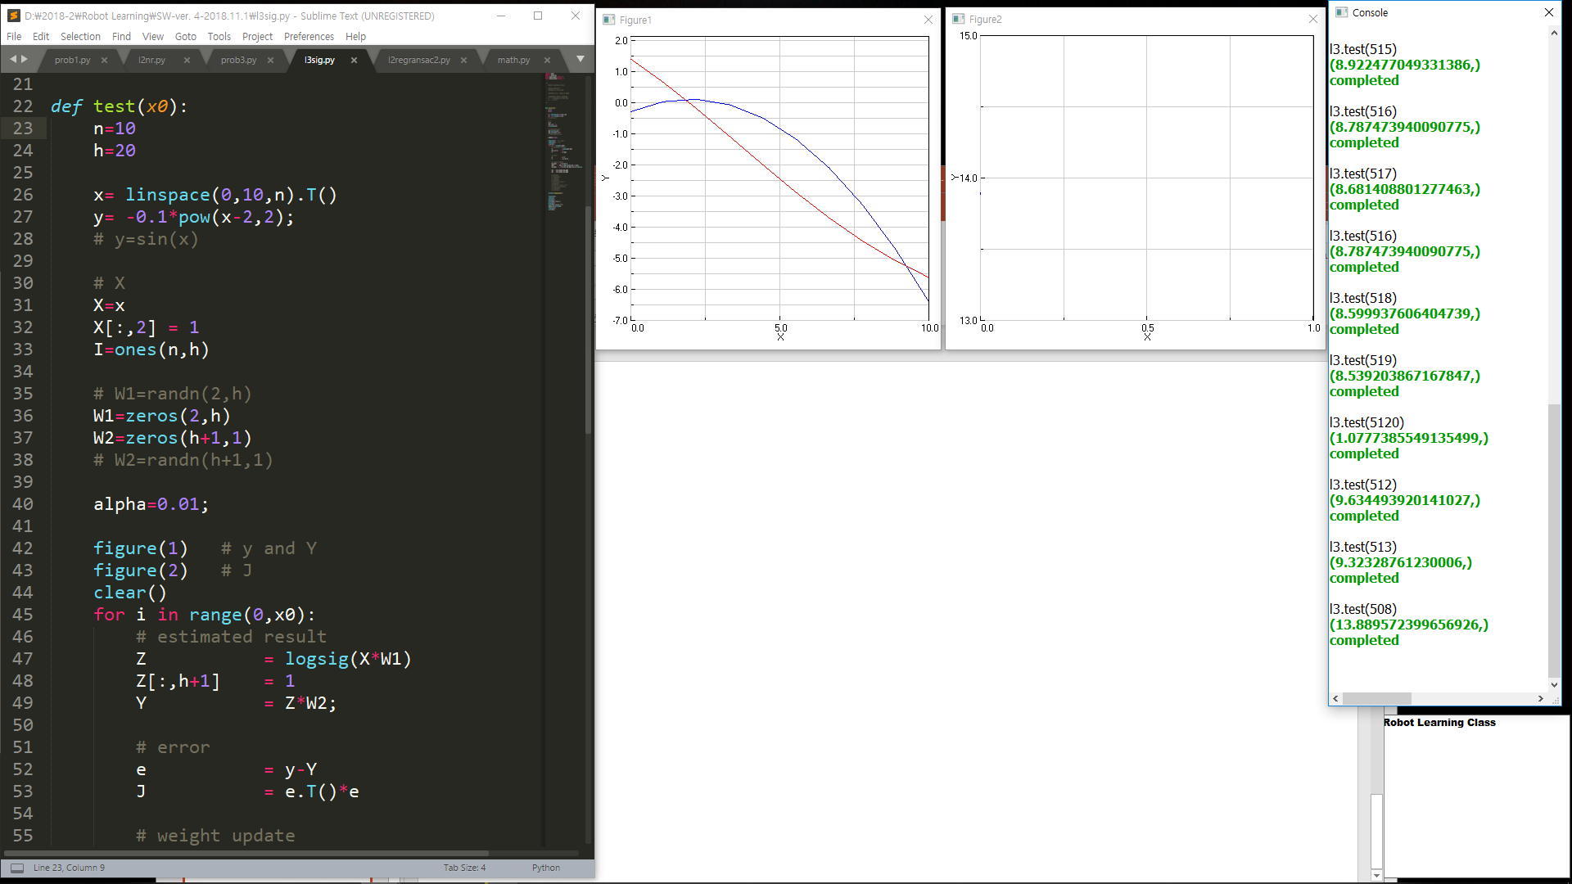
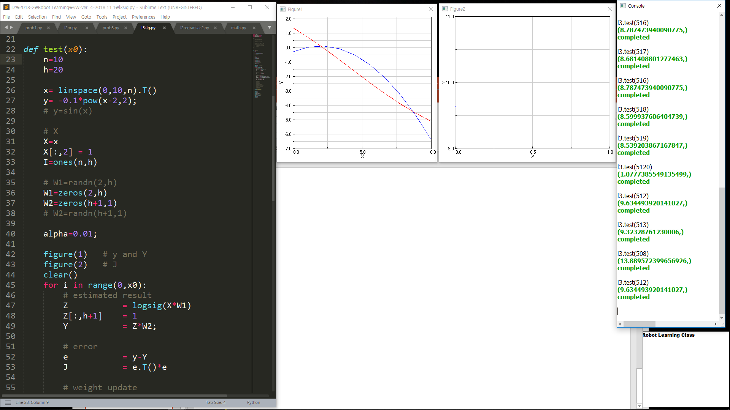


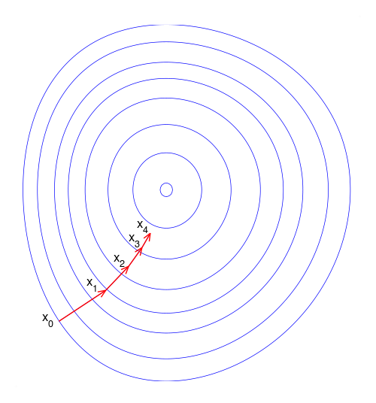
gradient descent 방법
해당 값들마다 병행적으로 결과 값을 구하면서 반복

Slide 7
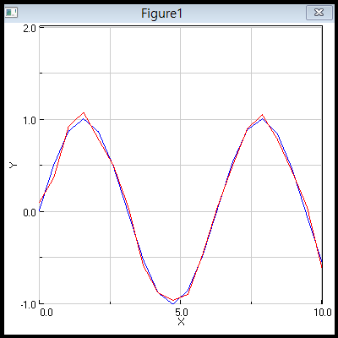
HW. 2.3. Using RBF for Y=Sin(x)
0<x<10 → X=linspace(0,10,20) N=20
Y = sin(X)

Slide 8
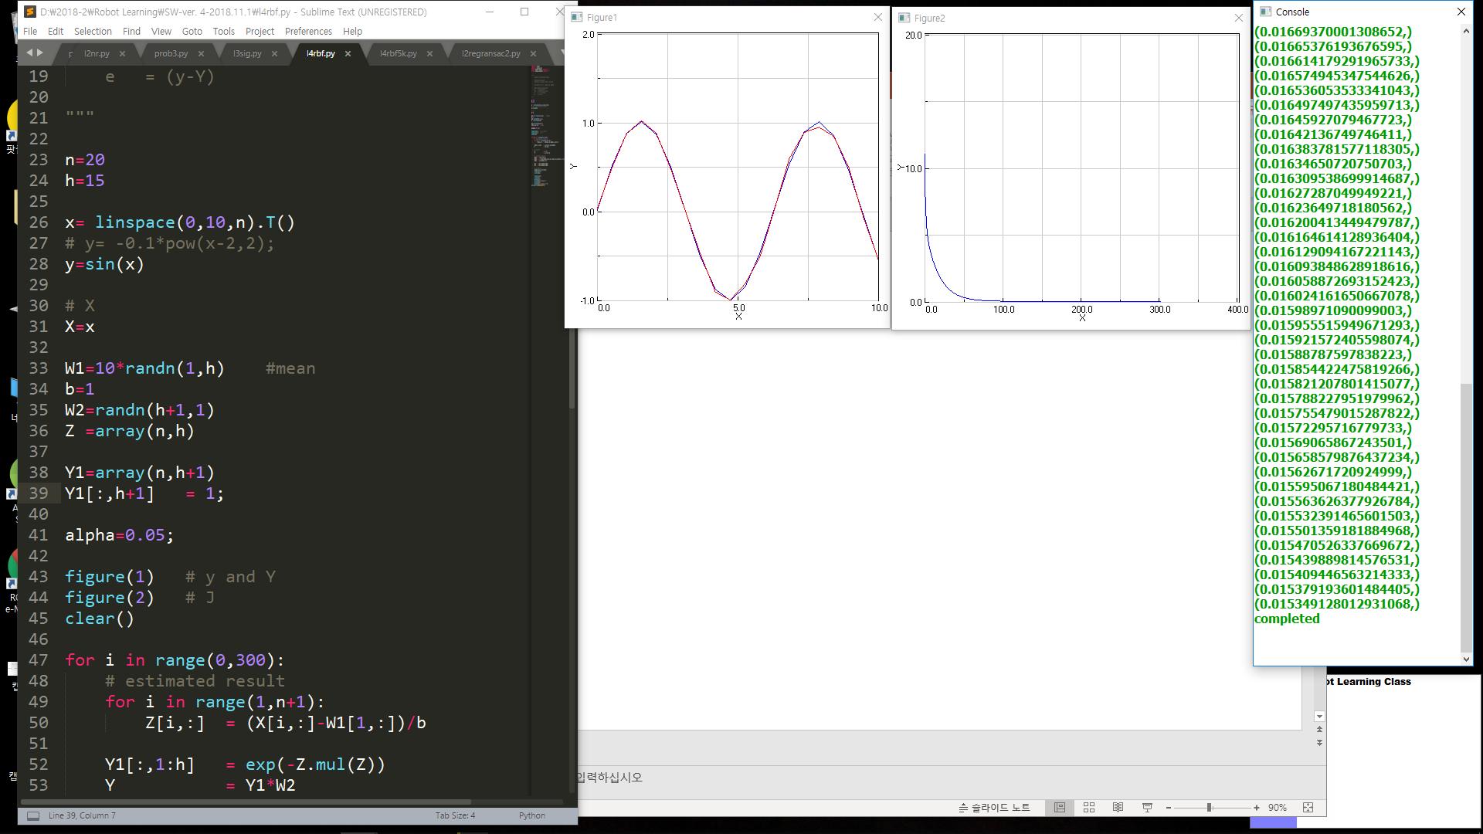

Slide 9
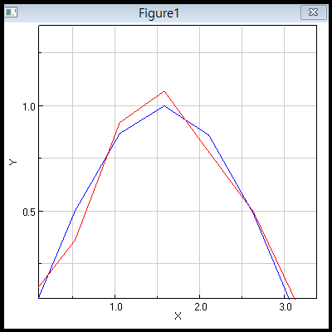
HW.2.4. Tell me What the differences are Between Sigmoidal and RBF NN
Iteration, Convergence, alpha, Initial value,
Anything is O.K.
HW.2.5. Why Sin(x) is so Dirty?
Find the Answer and the RESULT

Slide 10
Sigmoidal |  | RBF
6만 | 반복횟수 | 300
O | 수렴 | O
0.01 | alpha | 0.05
randn(2,h) | Initial | -1+12*randn(1,h)
튀는 값 O | J | 튀는 값 X..O

Slide 11

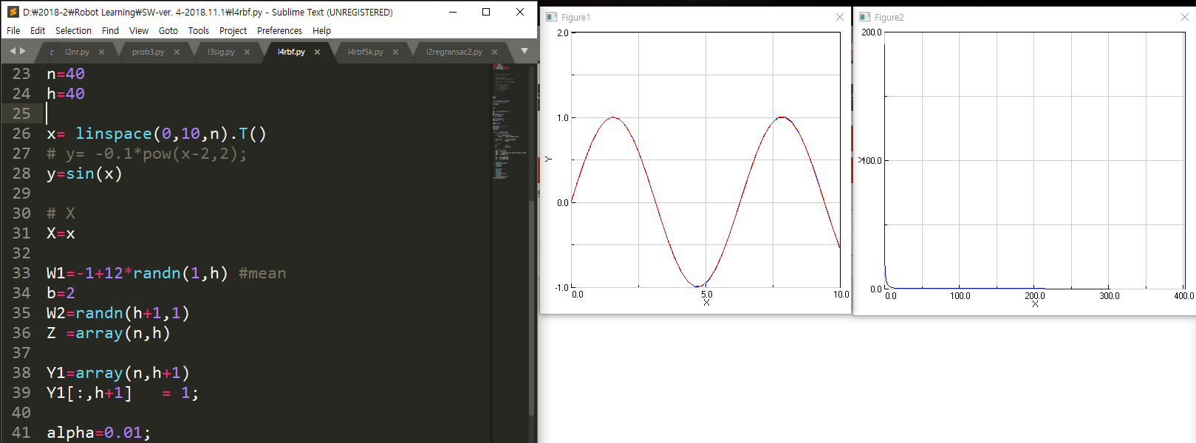

Slide 12
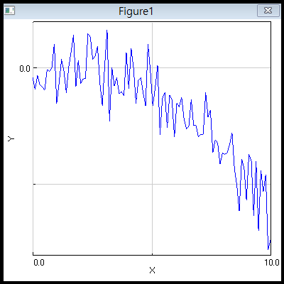
HW. 2.6 Noisy Data With RBF NN
n=100
X=linspace(0,1,10,n)
y= -0.1*pow(x-2,2)+randn(n)
Try RBF with the above x and y.
RBF becomes what?

Slide 13
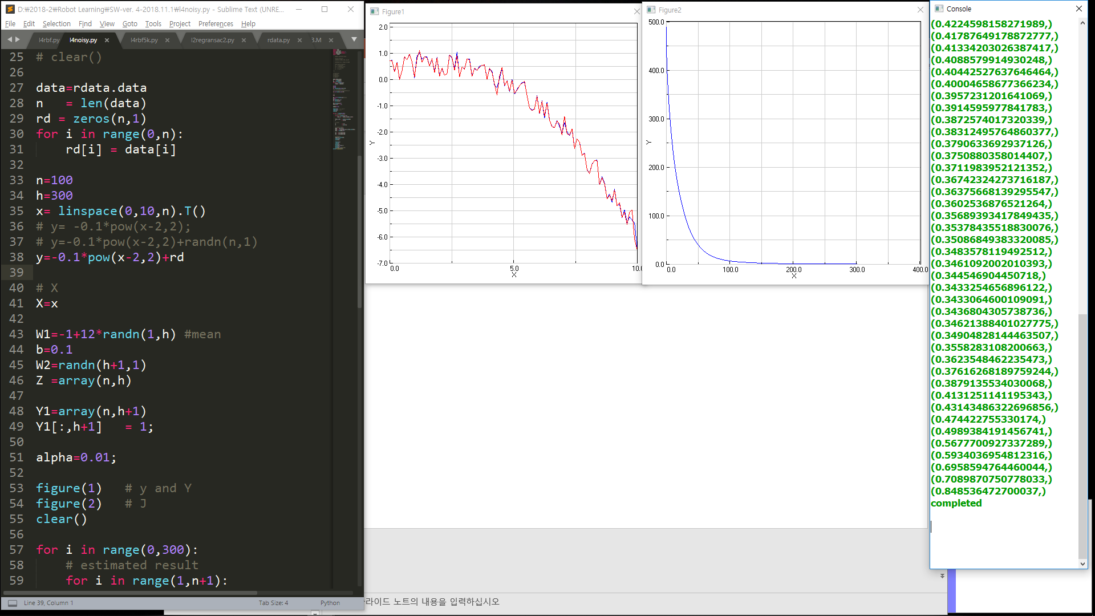
N=100 h=300
b=0.1
alpha=0.01

Slide 14
